Slide 1
TSAC Meeting
February 01, 2012

Slide 2
Fleet
80 buses
Employees
275 student drivers
20 budgeted drivers
8 supervisors
2 assistant managers
1 administrative assistant
1 senior office assistant
Services
Fixed Routes
16 routes (7 on-campus/9 off-campus)
Charters
Fiscal Year 2011
Fixed Route Ridership
4,917,172 rides
Charters
2,592 done
Expenses
Fuel: $1,110,058
Maintenance: $1,143,406
Oil: $44,155

Slide 3
Mentor

Slide 4
Camera Footage

Slide 5
Camera Footage

Slide 6
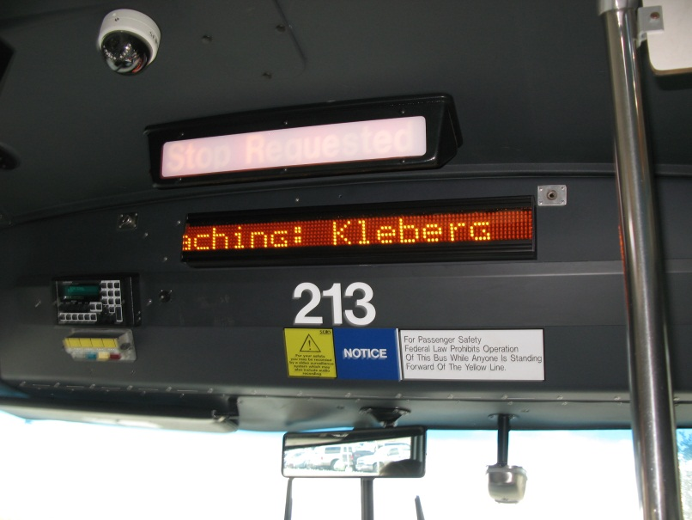
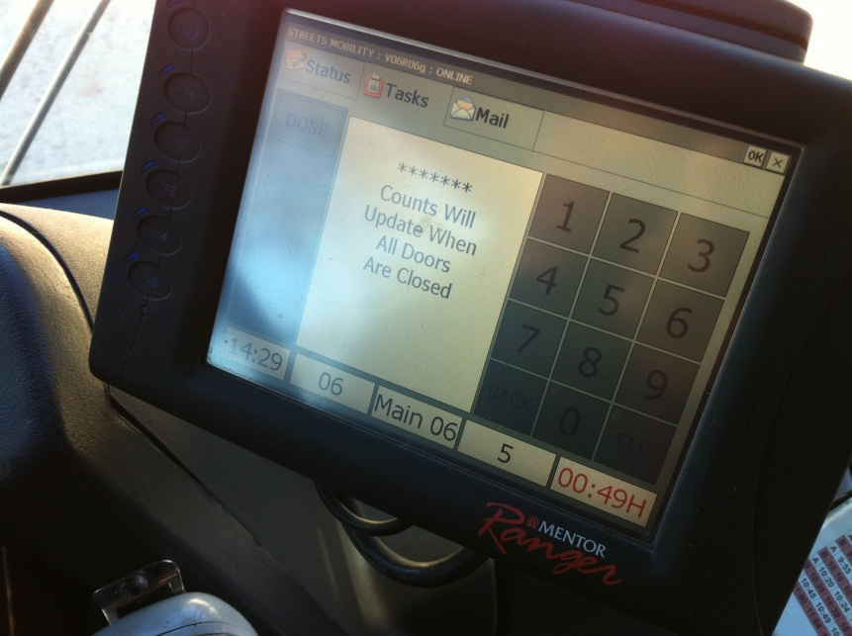
Mentor Software/Equipment
Ranger-on board computer terminal
APC-Automated Passenger Counters

Slide 7
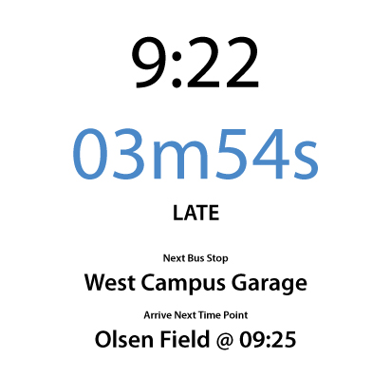
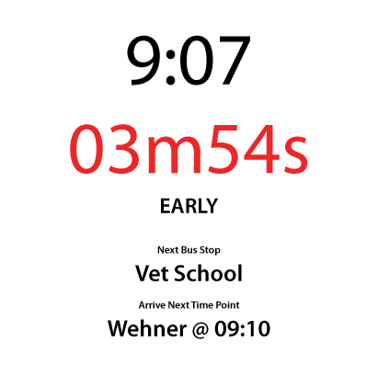
Mentor Software/Equipment

Slide 8
Interior Stop Annunciator

Slide 9
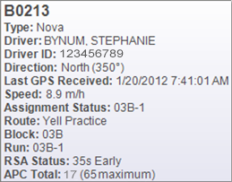
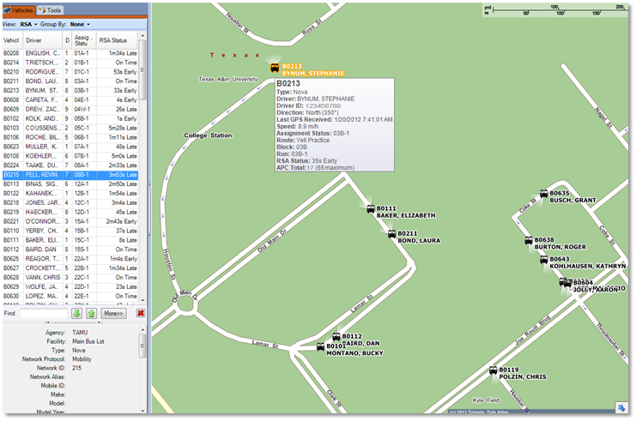
Dispatch App/Tracking of Bus Units

Slide 10
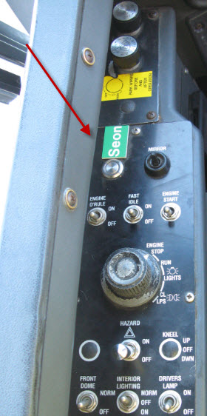
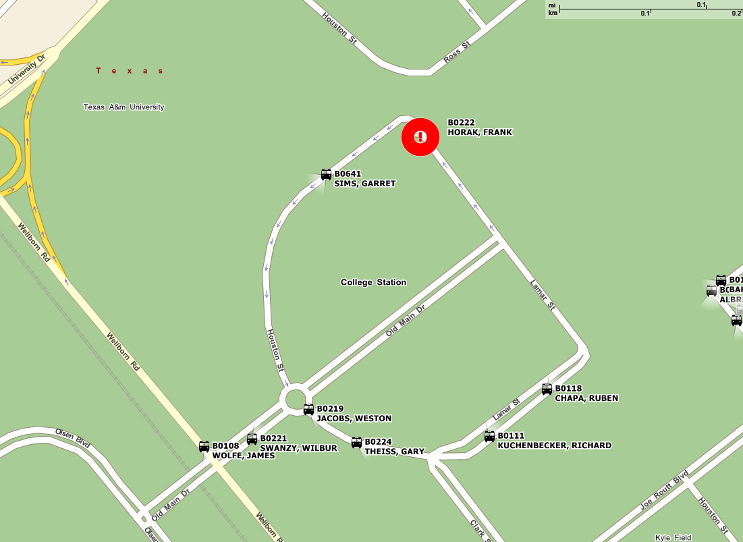
Driver Alerts & Dispatch

Slide 11
MSC Route Schedule Adherence

Slide 12
Route 36:Passengers and Late Buses

Slide 13
Customer View
Transportation Services Site (transport.tamu.edu)

Slide 14
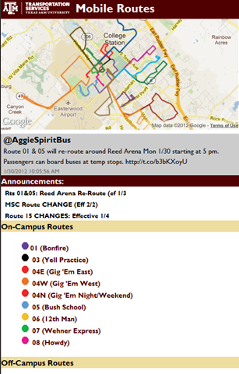
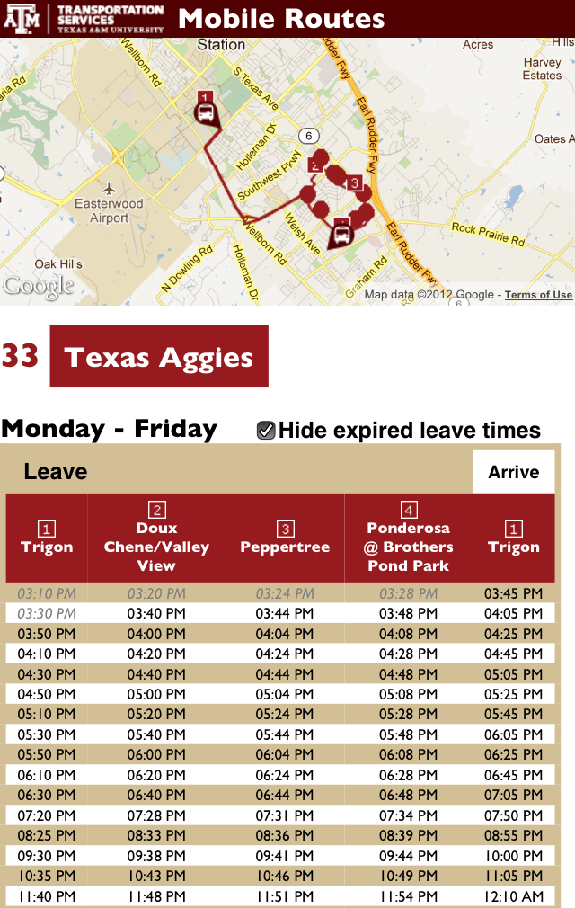
Customer View
Mobile Site (m.tamu.edu)

Slide 15
Mentor & Transit’s Future
Route Planning
Timing of routes
Route mapping options
See patterns of RR crossings, high/low traffic times, etc.
Determine number of units per route
Improve Transit Service

Slide 16
Questions?
Lana Wolken hwolken@tamu.edu
Justin Tippy jtippy@tamu.edu
Randy Davidson ardavidson@tamu.edu

